Slide 1

CHIT
CHAT

Slide 2
INHOUD

Slide 3
OPDRACHTOMSCHRIJVING
WERKING VAN DE SERVICES
VRAGEN
WERKING VAN DE APP
DEMO

Slide 4
Opdracht omschrijving

Slide 5
AANMELDEN
USERNAME AANPASSEN
QR-CODE SCANNEN
ZICH AFMELDEN
REGISTREREN
QR-CODE GENEREREN
GESPREK VOEREN

Slide 6
Werking van de APP

Slide 7
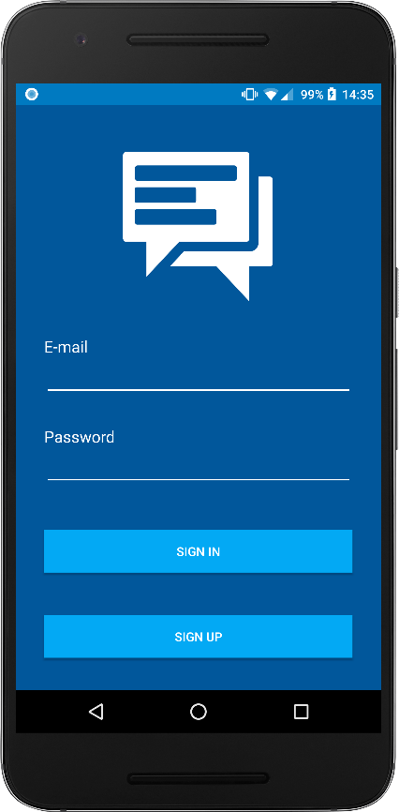
LOGIN VENSTER
AANMELDEN
EMAIL
WACHTWOORD
REGISTREREN

Slide 8
@Override public void onDataChange(DataSnapshot dataSnapshot) { if (dataSnapshot.exists()) { final Map data = (Map) dataSnapshot.getValue(); if(data.containsKey("firstName") && data.containsKey("lastName")) { Intent myIntent = new Intent(LoginActivity.this, MainActivity.class); LoginActivity.this.startActivity(myIntent); } else { Intent myIntent = new Intent(LoginActivity.this, UserNameActivity.class); LoginActivity.this.startActivity(myIntent); } } else { Intent myIntent = new Intent(LoginActivity.this, UserNameActivity.class); LoginActivity.this.startActivity(myIntent); } }

Slide 9
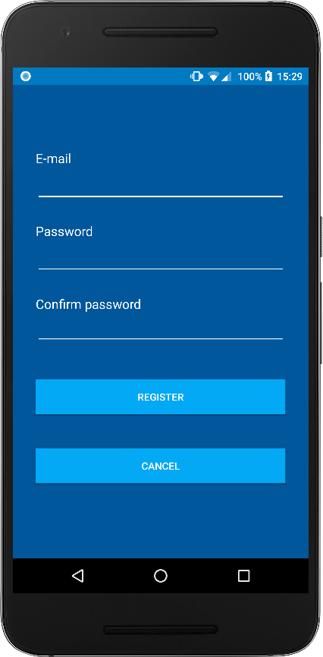
REGISTRATIE VENSTER
REGISTREREN
EMAIL
WACHTWOORD
WACHTWOORD BEVESTIGEN
ANNULEREN

Slide 10
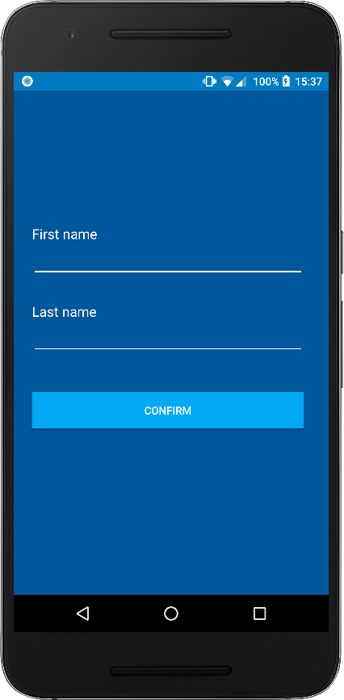
USERNAME VENSTER
NAAM INSTELLEN
VOORNAAM
ACHTERNAAM

Slide 11
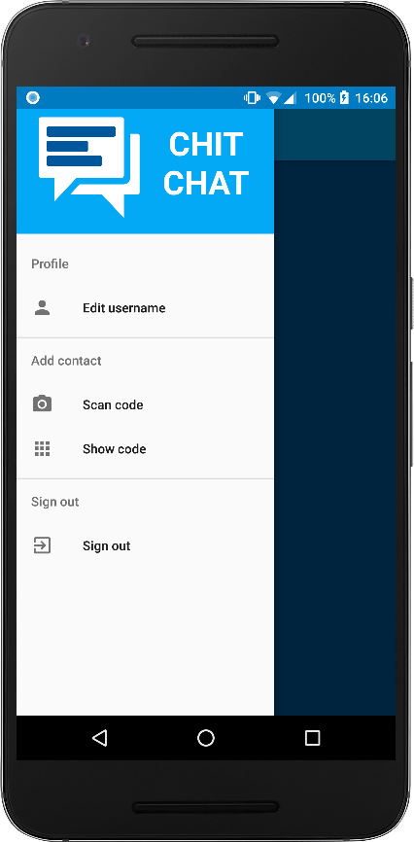
GESPREKKEN VENSTER
MENU
BEWERK NAAM
SCAN CODE
TOON CODE
AFMELDEN

Slide 12
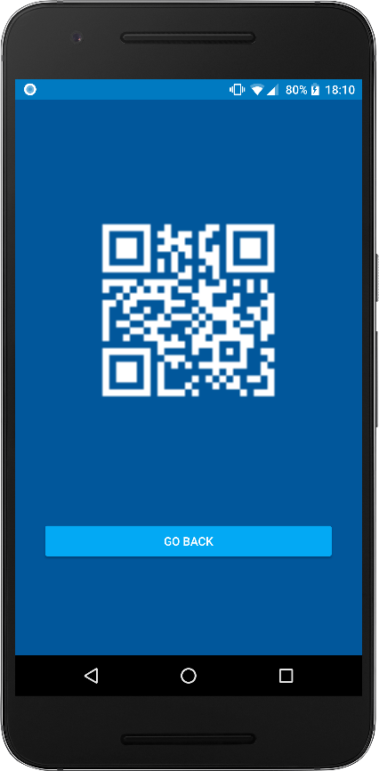
QR-CODE VENSTER
GENEREER QR-CODE
GEBRUIKERS UID

Slide 13
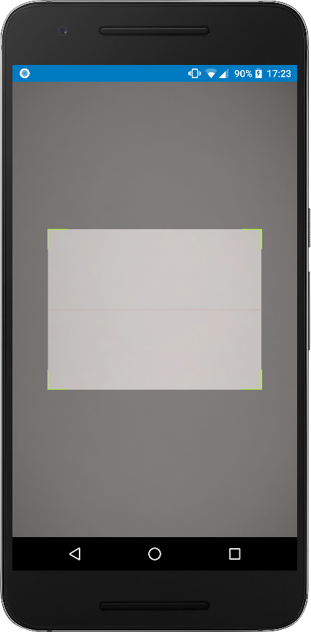
SCAN VENSTER
SCAN QR-CODE
CONTACTPERSOONS UID

Slide 14
if (id == R.id.nav_camera) { Intent myIntent = new Intent(MainActivity.this, ScannerActivity.class); MainActivity.this.startActivityForResult(myIntent, 0); }

Slide 15
@Override public void onBackPressed() { setResult(-1); finish(); scannerView.stopCameraPreview(); scannerView.stopCamera(); }
@Override public void handleResult(Result result) { String contactKey = result.getText(); setResult(0, new Intent().putExtra("contactKey", contactKey)); finish(); scannerView.stopCameraPreview(); scannerView.stopCamera(); }

Slide 16
@Override protected void onActivityResult(int requestCode, int resultCode, Intent data) { if(requestCode == resultCode){
… } }

Slide 17
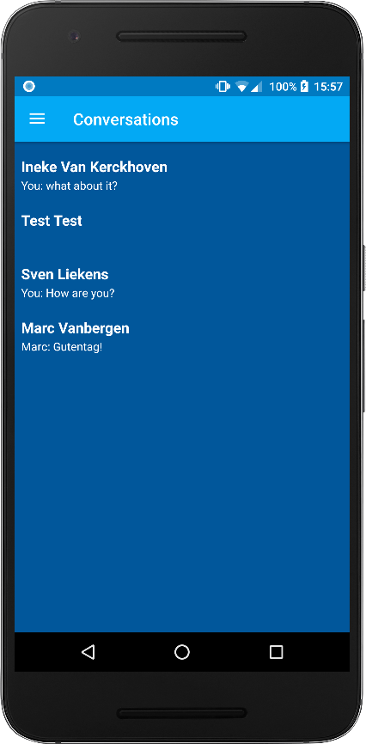
GESPREKKEN VENSTER
GESPREKKEN TONEN
CONTACTPERSOON
LAATSTE BERICHT ZENDER
LAATSTE BERICHT

Slide 18
public class Contact { private String contactKey = null; private String name = null; private String lastMessage = null; private String conversationKey = null; public void setContactKey(String contactKey){ this.contactKey = contactKey; } public void setName(String name){ this.name = name; }
…

Slide 19
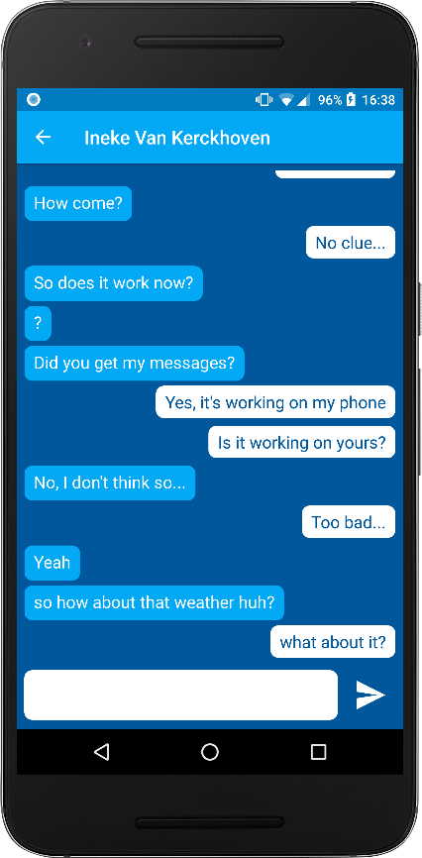
GESPREK VENSTER
OVERZICHT GESPREK
ONTVANGEN BERICHTEN
VERZONDEN BERICHTEN
BERICHTEN VERSTUREN

Slide 20
public class Message { public boolean sent; public String message; public Message(boolean sent, String message) { super(); this.sent = sent; this.message = message; } }

Slide 21
public View getView(int position, View convertView, ViewGroup parent) { Message messageObject = getItem(position); View row = convertView; LayoutInflater inflater = (LayoutInflater) this.getContext().getSystemService(Context.LAYOUT_INFLATER_SERVICE); if (messageObject.sent) { row = inflater.inflate(R.layout.sent_message, parent, false); }else{ row = inflater.inflate(R.layout.received_message, parent, false); } chatText = (TextView) row.findViewById(R.id.msgr); chatText.setText(messageObject.message); return row; }

Slide 22
<LinearLayout xmlns:android="http://schemas.android.com/apk/res/android" android:layout_width="match_parent" android:layout_height="match_parent" android:orientation="vertical"> <TextView android:id="@+id/msgr" android:layout_width="wrap_content" android:layout_height="wrap_content" android:layout_gravity="right" android:layout_marginBottom="8dp" android:layout_marginLeft="20dp" android:background="@drawable/message_sent" … </LinearLayout>

Slide 23
<RelativeLayout xmlns:android="http://schemas.android.com/apk/res/android" android:layout_width="match_parent" android:layout_height="match_parent"> <TextView android:id="@+id/msgr" android:layout_width="wrap_content" android:layout_height="wrap_content" android:layout_gravity="left" android:layout_marginBottom="5dp" android:layout_marginRight="20dp" android:background="@drawable/message_received" android:paddingBottom="8dp" … </RelativeLayout>

Slide 24
Werking van services

Slide 25
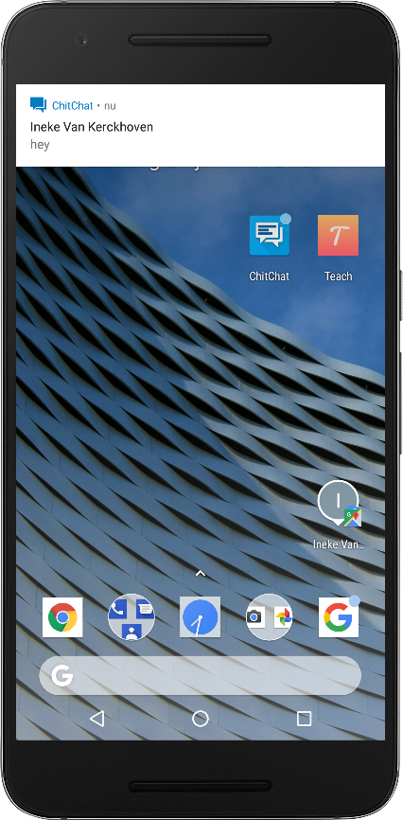
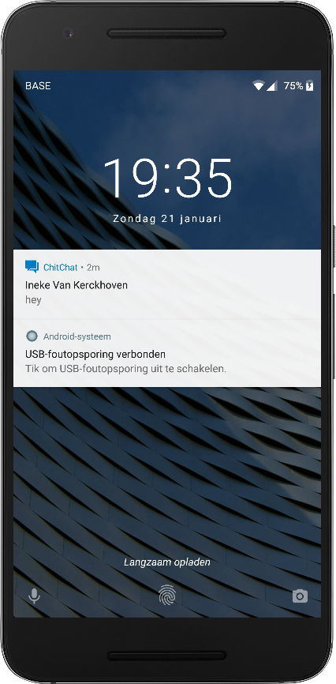
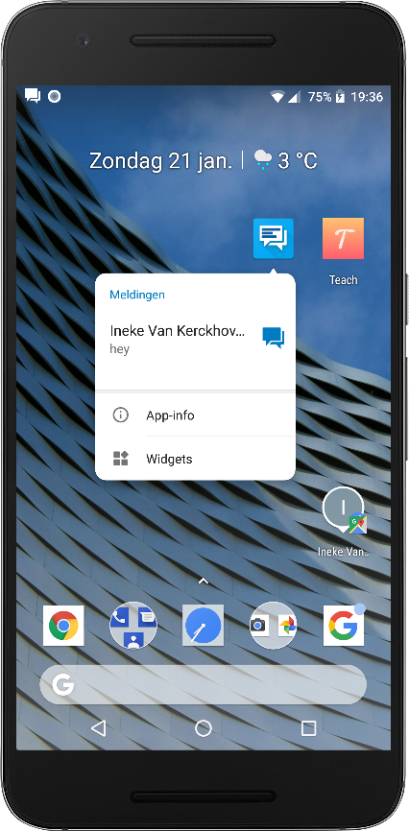
MELDING SERVICE
MELDINGEN
VISUELE FEEDBACK
AUDITIEVE FEEDBACK
HAPTISCHE FEEDBACK
OPENT APP

Slide 26
notificationManager = (NotificationManager) getSystemService(Context.NOTIFICATION_SERVICE); notificationChannelId = "notification_channel"; notificationChannel = new NotificationChannel
(notificationChannelId, "notifications", NotificationManager.IMPORTANCE_HIGH); notificationChannel.setDescription("message notifications"); notificationChannel.enableLights(true); notificationChannel.setLightColor(Color.BLUE); notificationChannel.setVibrationPattern(new long[] {0, 250, 250, 250}); notificationManager.createNotificationChannel(notificationChannel);

Slide 27
NotificationCompat.Builder notificationBuilder = new NotificationCompat.Builder (this, notificationChannelId) .setSmallIcon(R.drawable.ic_logo) .setContentTitle(title) .setContentText(content) .setAutoCancel(true) .setColor(0xFF03a9f4); Intent resultIntent = new Intent(this, LoginActivity.class); TaskStackBuilder stackBuilder = TaskStackBuilder.create(this); … notificationManager.notify(notificationId, notificationBuilder.build());

Slide 28
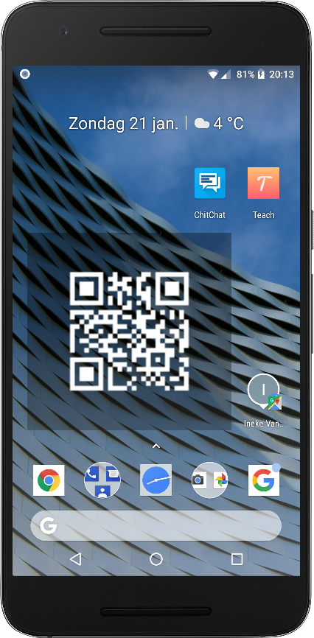
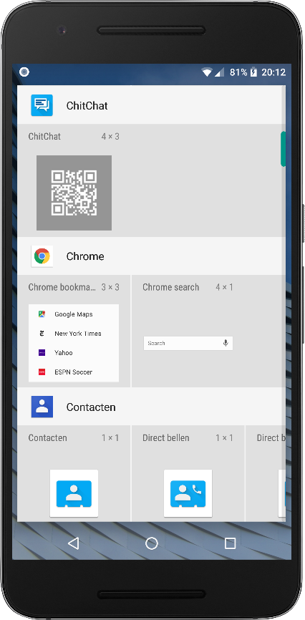
WIDGET SERVICE
EXTERNE FUNCTIONALITEIT
TOON QR-CODE
GEBRUIKERS UID

Slide 29
public class WidgetProvider extends AppWidgetProvider { private SharedPreferences savedValues; private String UID; private ImageView QrCodeImageView; @Override public void onUpdate (Context context, AppWidgetManager appWidgetManager, int[] appWidgetIds) { … } }

Slide 30
DEMO

Slide 31
VRAGEN?

